Slide 1

Steps in writing a research proposal: tips to avoid common mistakes
MANSOUR AMINI
Email: Mansour@usm.my
https://www.researchgate.net/profile/Mansour-Amini

Slide 2
NO IMPACT!
What is impactful RESEARCH?
Clear and Relevant Problem Statement
Compelling Research Questions
Well-Defined Objectives
Strong Theoretical Framework
Methodological Rigor
Significance
Literature Review Quality
Feasibility and Scope
Ethical Considerations

Slide 3
MORE IMPACTFUL?!
Alignment with SDGs [e.g., SDG 4, Quality Education]
Interdisciplinary Approach [e.g., technology, AI, science, social sciences]
Broader Societal Impact [e.g., on communities]
Collaborative Potential [e.g., with industry]
Scalability and Adaptability [e.g., application in different contents]

Slide 4


SDGS BY UN
[source: https://sdgs.un.org/goals]

Slide 5
Topic selection
Identify a Research Gap: Relevance and Importance
Feasibility
Interest and Passion
Current Trends
Originality
Alignment with Expertise

Slide 6
Expertise
FIND REAL EXPERTS! VERIFY THEIR EXPERTISE.
Gain knowledge consistently, obtain official certifications by attending courses and programmes, and utilize expert validation.
Always work closely with true certified experts, not self-claimed ones!

Slide 7
Title
What is a ‘good’ title?
How many words?

Slide 8
A good title …
should convey the essence of the study without overwhelming the reader. The title should also include keywords to reflect the main focus, variables, and context of the research [place and type of participants (if applicable)], making it both precise and informative.

Slide 9
Why are these “good” and impactful titles?
Exploring the Role of Artificial Intelligence in Personalized Medicine: Ethical Implications and Healthcare Outcomes
Unpacking the Socioeconomic Impacts of Mental Health Education among Adolescents in Rural Areas in a country/region/province…
Evaluating the Effects of Digital Transformation on Workforce Productivity and Wellbeing in the Post-Pandemic Era

Slide 10
Analyze this example: is it a good title for phd?
A study on the analysis of several health and fitness issues in a community in South America

Slide 11
Background of the study
Contextual Overview
Example: “In recent years, the rapid rise of digital communication has transformed social interaction patterns worldwide, raising new questions about privacy, misinformation, and psychological well-being.”
Historical Background
Example: “Since the invention of the internet, digital communication platforms have evolved from simple email exchanges to complex social media ecosystems. This evolution has shifted the way people communicate, impacting social structures and cultural norms.”
Current Landscape
Example: “Today, social media plays an influential role in shaping public opinion, but it also raises concerns about echo chambers and the spread of misinformation. Scholars continue to debate the implications of these platforms on mental health and democracy.”
Relevant Literature
Example: “Extensive research has been conducted on the effects of social media on mental health, particularly focusing on issues like self-esteem, social comparison, and loneliness. For instance, studies by Smith et al. (2020) indicate a strong correlation between social media usage and anxiety levels among teenagers.”
Research Gap Identification
Example: “While prior studies have focused on individual mental health outcomes, there is limited research on the potential for digital platforms to offer positive psychological benefits, such as resilience and social support. This gap suggests a need to investigate the potential for these platforms to contribute to mental well-being.”
Rationale for the Study
Example: “This study aims to explore how digital communication tools can be designed to promote positive mental health outcomes, thereby advancing the current understanding of social media's potential as a tool for psychological resilience. Insights from this research may inform platform design strategies that mitigate adverse effects while enhancing user well-being.”

Slide 12
question
Can you suggest the best title based on the given background in the previous slide?

Slide 13
Sample answer
How about …?
Digital Communication and Mental Health: A Study on Leveraging Social Media for Psychological Resilience?
Promoting Psychological Resilience through Digital Communication: Exploring the Positive Potential of Social Media

Slide 14
Problem statement
TWO MODELS:
1. GAP & ITS SIGNIFICANCE
Example: “Despite the significant use of social media, little is known about its potential benefits for mental well-being. Understanding this relationship could inform the design of healthier digital platforms [evidence].”
2. IDEAL/CURRENT/CONSEQUENCE
Example: “Ideally, digital platforms should enhance mental well-being [evidence], but currently, many users experience anxiety and self-esteem issues linked to social media use [evidence]. Without research into positive digital design, these issues may worsen, impacting public health [evidence].”

Slide 15
note
Remember GAP can be a minor problem if its significance is not well-justified.
Not every gap qualifies to be filled, especially at Phd level, as there are millions out there! What makes your so different or special?

Slide 16
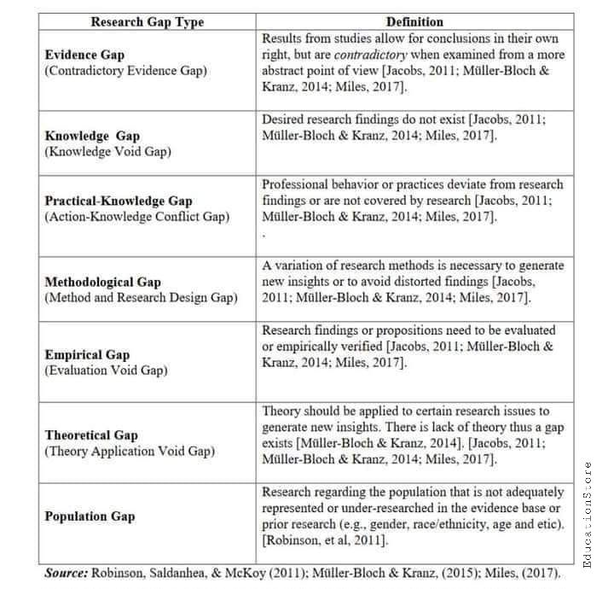

Slide 17

How to write an effective problem statement section
Clearly Define the Problem
Contextualize the Problem
Evidence of the Problem
Impact of the Problem
Knowledge Gaps
Purpose Connection to the problem

Slide 18
Example
“Developing an Ethical Framework for the Use of AI Tools in Academic Writing: Integrating Information Literacy and Educational Ethics”
COPYRIGHT @ Mansour Amini
Context/Background: The use of AI tools in educational settings, focusing on academic writing.
Specific Problem: Ethical concerns such as plagiarism, fairness, and data privacy are not sufficiently addressed.
Evidence/Justification: References to recent studies (e.g., Johnson et al., 2023; Smith & Lee, 2022) and organizations (e.g., ALA, ACRL) emphasize the issue's importance.
Gap in Knowledge: Lack of a standardized ethical framework for AI in academic writing.
Relevance: Essential for maintaining academic integrity and equitable learning.
Purpose Statement: Proposes to create a conceptual framework for ethical AI use in academic writing.

Slide 19
Sample of extended version
The adoption of artificial intelligence (AI) in educational settings has shown potential for enhancing personalized learning and administrative efficiency (EVIDENCE). However, significant challenges persist regarding the ethical use of AI tools in academic writing. Concerns about plagiarism detection, fairness, data privacy, and the quality of academic integrity have been widely discussed (EVIDENCE). Despite the implementation of AI tools such as plagiarism checkers and writing assistants, there is limited research on a standardized framework that ensures their ethical and responsible use in higher education.
Studies highlight that while AI-powered tools can assist students in improving their writing skills, unregulated use can lead to academic dishonesty and overreliance (EVIDENCE). Additionally, concerns about bias in AI algorithms have raised questions regarding fairness and equity, as some tools may favor specific writing styles or cultural norms (EVIDENCE). The American Library Association (ALA) and the Association of College and Research Libraries (ACRL) have emphasized the need for guidelines that align AI use with academic and information literacy principles (EVIDENCE).
Despite these calls, existing literature lacks a comprehensive framework that balances the advantages of AI with ethical considerations in academic writing practices. Addressing this gap is critical to fostering a learning environment that leverages technology without compromising academic standards or fairness. Therefore, this study aims to propose a conceptual framework for the ethical use of AI tools in academic writing, incorporating perspectives from information literacy models and educational ethics.

Slide 20
Objectives
Directly Linked to Research Questions [corresponding]
Clear and Measurable
Action-Oriented Language: Use verbs like “explore,” “examine,” “analyze,” or “evaluate” to specify the study's goals.
Broad and Specific Objectives: Start with a broad objective to capture the study's main aim, then outline specific objectives to break down the study into manageable parts.

Slide 21
Examples of clear objectives
To analyze the current ethical challenges associated with the use of AI tools in academic writing, including concerns about plagiarism detection, fairness, data privacy, and academic integrity.
To examine the impact of using AI tools on EFL learners’ academic writing.
To develop a comprehensive conceptual framework for the ethical and responsible use of AI tools in academic writing that incorporates perspectives from information literacy models and educational ethics.

Slide 22
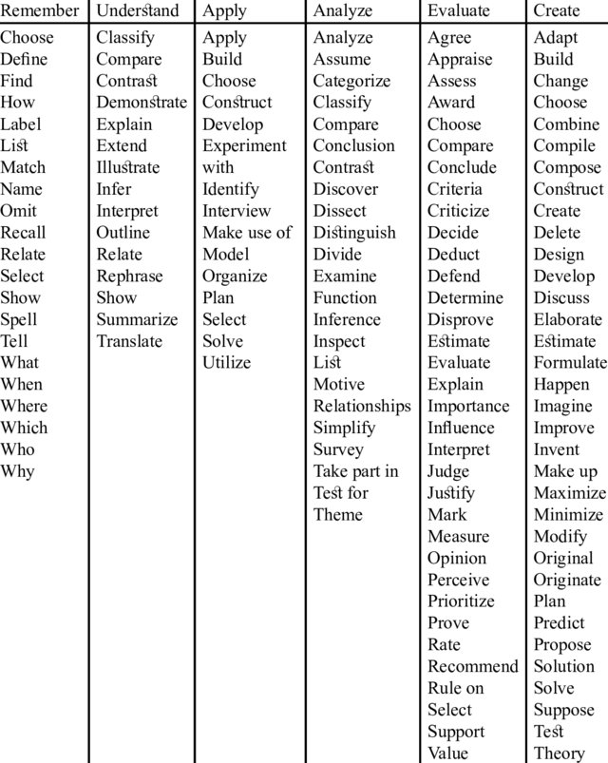
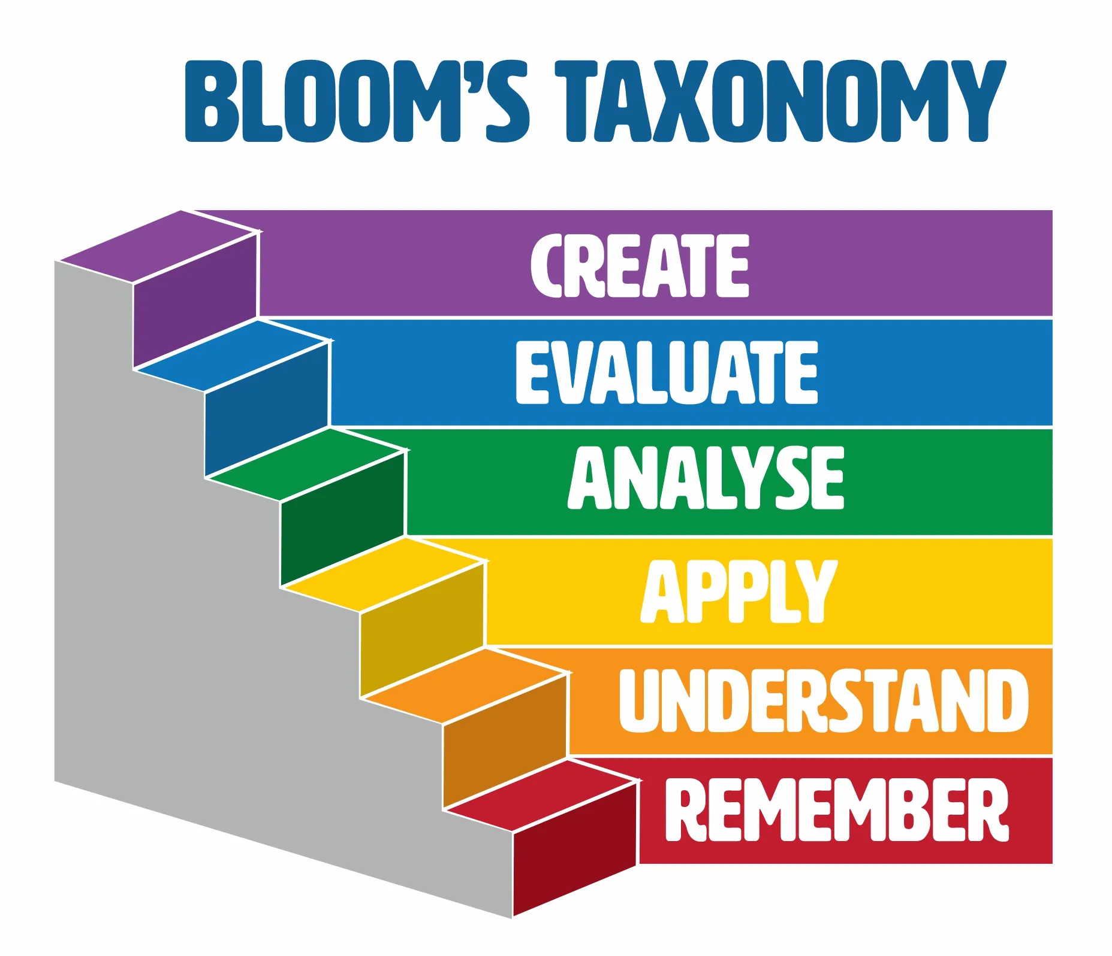
Revised Bloom's Taxonomy action verbs

Slide 23
research questions
Derived from the Problem Statement
Clear and Focused
Open-Ended (if applicable): For exploratory studies, frame questions to encourage in-depth investigation rather than simple yes/no answers.
Aligned with Methodology: Questions should align with the chosen research methods (e.g., quantitative questions often begin with "To what extent" or "How many," while qualitative questions may ask "How" or "Why").
Logical Sequence: Arrange questions in a logical order to create a coherent flow for the study.

Slide 24
EXAMPLES OF CLEAR RESEARCH QUESTIONS
How is/what are the current ethical challenges associated with the use of AI tools in academic writing? [qualitative]
What is the impact of using AI tools on EFL learners’ academic writing? [quantitative]
What valid and reliable framework could be developed for the ethical use of AI tools in academic writing that incorporates perspectives from information literacy models and educational ethics? [mixed methods]
Note: “to what extent” is used in descriptive questions only.

Slide 25
Hypotheses
Definition of Hypothesis
specific, testable statement or prediction about the expected relationship between variables in a study.
formulated based on existing theories or prior research and is used as a basis for investigation.
guides the research process by establishing what the researcher intends to prove or disprove through empirical evidence.
Types of Hypotheses
  Null Hypothesis (H₀): Proposes no relationship or effect between variables (e.g., "There is no significant relationship between X and Y").
  Alternative Hypothesis (H₁): Suggests a relationship or effect exists between variables (e.g., "There is a significant positive relationship between X and Y").

Slide 26
Characteristics of hypotheses
Alignment with Research Questions
Clarity and Specificity
Measurable Variables
Direction (if applicable): If the hypothesis predicts a direction (e.g., "positive correlation"), specify this to clarify expectations.

Slide 27
Examples of clear hypotheses
H0. There is no relationship between using AI tools and EFL learners’ academic writing.
H1. There is a significant positive relationship between using AI tools and EFL learners’ academic writing.
These two examples can be answered with:
Correlation Analysis (Pearson Correlation Coefficient if data distributed normally; Spearman Rank Correlation if the data is not normally distributed)
Regression Analysis (Simple Linear Regression to predict the dependent variable (academic writing performance) based on the independent variable (use of AI tools) by assessing the strength and nature of the relationship.
T-tests [Independent Samples T-test if we categorize EFL learners into two groups (those who use AI tools and those who do not) to compare their academic writing scores and see if there’s a significant difference)
ANOVA if there are multiple levels of AI tool usage (e.g., no use, moderate use, high use) to compare means across these groups.
NOTE: THE CONTENT AND DATA ARE ONLY FOR EXEMPLIFICATION PURPOSE.

Slide 28
Note on Selection of Tests
The choice of statistical test depends on the data distribution, measurement levels of the variables, and the specific nature of the hypotheses. It's essential to conduct preliminary tests (like normality tests, i.e., visual inspection and statistical test such as Shapiro-Wilk test in SPSS) to determine the appropriate analysis method.
Software Tools: These analyses can be performed using statistical software such as SPSS, R, Python, or Excel, which provide built-in functions for conducting these tests.

Slide 29
Complex hypotheses: Multi-Variable Interactions
Examples
Complexity Factors:
  *Moderators: The influence of parental involvement complicates the direct relationship between AI tools use and EFL learners’ academic writing performance.
    H1: The relationship between the use of AI tools and EFL learners’ academic writing performance is significantly moderated by parental involvement [i.e., The higher levels of parental involvement strengthen the positive relationship between AI tool usage and EFL learners’ writing performance].
    AI Tools Usage → EFL Learners' Academic Writing Performance ↑ Parental Involvement
  **Mediators: The role of anxiety levels as a mediator adds another layer of analysis.
    H1. Anxiety levels mediate the relationship between the use of AI tools and EFL learners’ academic writing performance [i.e., Increased use of AI tools leads to lower anxiety levels, which in turn results in higher academic writing performance among EFL learners].
    AI Tools Usage → Anxiety Levels → EFL Learners' Academic Writing Performance
*A moderator affects the strength or direction of the relationship between an independent variable and a dependent variable. Test by Hierarchical Multiple Regression Analysis or SEM
**A mediator explains how or why one variable affects another. Test by Baron and Kenny's Four Steps or SEM

Slide 30
significance of the study
Contribution to Knowledge
  This study contributes to the existing body of knowledge by providing a nuanced understanding of how AI tools impact EFL learners' academic writing performance. Previous research has primarily focused on the efficacy of AI tools in language learning (e.g. EVIDENCE), but this study uniquely explores the moderating effects of parental involvement and the mediating role of anxiety. Potential findings could amplify the positive effects of AI tool usage on academic writing, revealing a previously unexplored intersection in educational technology research.
Theoretical
Theoretical frameworks surrounding technology-enhanced learning and academic performance are further developed through this research. By integrating models of parental involvement and self-regulated learning, the study proposes a new theoretical lens that emphasizes the social context of AI tool usage. If parental engagement correlates with improved writing performance when AI tools are utilized, existing theories that focus solely on individual learner characteristics can be challenged (EVIDENCE).
Practical
This study offers practical strategies for educators and policymakers to optimize the use of AI tools in language learning environments. For instance, some studies suggest that workshops aimed at increasing parental involvement could enhance students' writing performance by maximizing the effectiveness of AI tools. A pilot program implemented in three schools showed a 25% increase in student writing scores when parents were actively involved in AI-assisted learning (EVIDENCE).
NOTE: THE CONTENT AND DATA ARE ONLY FOR EXEMPLIFICATION PURPOSE.

Slide 31
CONT.
Academic Impact
  The significance of this research extend to academic institutions, promoting a reevaluation of curricula to incorporate parental engagement strategies alongside AI tool usage. The study has the potential to influence course design, leading to more collaborative and supportive educational environments. Notably, a collaborative approach could improve student writing performance by an average of 15% compared to traditional methods (EVIDENCE).
Policy or Practice Relevance
  Given the findings that parental involvement significantly moderates the effects of AI tool usage, educational policymakers may consider integrating parental engagement initiatives into existing frameworks. This research supports the implementation of policies that encourage collaboration between parents, educators, and technology developers, potentially resulting in improved student outcomes. As highlighted in a recent policy brief by the (EVIDENCE), fostering partnerships among these stakeholders can enhance the efficacy of educational technologies.
Beneficiaries of the Study
  The primary beneficiaries of this research include EFL learners, educators, and parents. EFL learners stand to gain improved writing skills through the effective integration of AI tools and parental support. Educators can utilize the findings to refine instructional strategies, while parents can better understand their role in facilitating their children’s learning processes. As evidenced by a survey results (EVIDENCE), 85% of parents expressed a desire to engage more with educators to support their children’s use of AI tools.
  Advancement of Models, Approaches, etc.
    This study advances existing models of educational technology by proposing an integrated framework that encompasses parental involvement, anxiety levels, and AI tool usage. Anxiety might act as a mediator in the relationship between AI tools and writing performance, leading to the development of a new model that educators can employ to enhance student engagement and performance. Early testing of this model in other studies (EVIDENCE), indicates a 20% increase in student writing proficiency when anxiety levels are addressed in conjunction with AI tool training (EVIDENCE).
NOTE: THE CONTENT AND DATA ARE ONLY FOR EXEMPLIFICATION PURPOSE.

Slide 32
Operational definitions
Define Key Terms
Contextual Meaning
Measurable Elements: If applicable, define how abstract concepts will be measured or observed (e.g., "academic achievement" measured by GPA).
Consistency
Avoid Jargon
Examples (if needed): If a term has complex meaning, consider providing an example for clarity.
Use in the present/this study/research,….

Slide 33
Literature Review
Conduct a thorough review of the existing literature to highlight the gaps your research will address. Make sure to include recent studies and key theories.
Common Mistake: Repeating general information from sources without critically analyzing them. Avoid overly long summaries of individual studies without drawing connections to your research.

Slide 34
Methodology
Provide a detailed explanation of the research design, methods of data collection, analysis techniques, and the rationale for choosing them.
Common Mistake: Failing to explain why you have chosen specific methods or not being specific enough. Avoid vague terms like "qualitative" without specifying the methods (e.g., interviews, case studies).

Slide 35
Theoretical Framework
Provide a clear explanation of the theories or models guiding your research. Show how they align with your research questions.
Common Mistake: Neglecting to link your theoretical framework with your research questions. Avoid using a framework that doesn't add value to your research or aligns poorly with your objectives.

Slide 36

CONCLUSION & FINAL THOUGHTS

Slide 37
conclusion
Clarity is key: Write in clear, concise language, avoiding jargon or overly complex sentences.
Consistency: Be consistent in terminology, structure, and formatting throughout the proposal.
Proofread: Ensure your proposal is free of grammatical and typographical errors. Double-check for clarity and coherence.
Tailor to the audience: Ensure that your proposal meets the expectations of the funding agency, institution, or committee reviewing it.
Be realistic: Don't overpromise what your research can achieve. Be clear about the scope and limitations.

Slide 38

A detailed qualitative FORMAT (Creswell, 2014)
Introduction
  Statement of the problem (including existing literature about the problem, deficiencies in the literature, and relevance of study for audiences)
  Significance & Purpose of the study
  The research questions
  Methodology/Procedure
    Philosophical assumptions or worldview of qualitative research (e.g. constructivist)
    Qualitative design (e.g., ethnography, case study)
    Role of the researcher
    Data collection procedures (sampling, population, participants, etc.)
    Data analysis procedures (e.g. use of software, analysis procedures, etc.)
    Strategies for validating findings
    Ethical issues
    References
      Appendices: Interview questions, observational forms

Slide 39

A detailed quantitative format (creswell, 2014)
Introduction
Statement of the problem (issue, existing literature about problem, deficiencies in literature, relevance of study for audiences)
Purpose of the study
Research questions or hypotheses
Theoretical perspective
Review of the literature (theory may be included in this section instead of the introduction)
Methods Type of research design (e.g., experimental, survey)
  Population, sample, and participants
  Data collection instruments, variables, and materials
  Data analysis procedures
  Reliability & validity
  Ethical issues
  References
  Appendices: Instruments

Slide 40

A detailed mixed methods format (creswell, 2014)
Introduction
  The research problem (existing research on the problem, deficiencies in the literature, relevance of study for audiences)
  The purpose or study aim and reasons or rationale for a mixed methods study
  The research questions and hypotheses (quantitative questions or hypotheses, qualitative questions, mixed methods questions)
  Philosophical foundations for using mixed methods research
  Literature review (optional review quantitative, qualitative, and mixed methods studies)
  Methods
    A definition of mixed methods research & The type of design used and its definition & Challenges in using this design and how they were addressed
    Quantitative data collection & data analysis & Qualitative data collection & data analysis & Mixed methods data analysis procedures
    Validity approaches in both quantitative and qualitative research
    Ethical issues
    References
    Appendices: Instruments, diagrams

Slide 41
Main SOURCES
Johnson, R.B. & Christenson, L. (2014). Educational research: Quantitative, qualitative, and mixed approaches. Sage. USA.
Creswell, J. (2014). Research Design: Qualitative, quantitative, and mixed methods approaches. SAGE. US.
Creswell, J. & Guetterman, T. (2012). Educational research. Planning, conducting, and evaluating quantitative and qualitative Research. Pearson Education. US.

Slide 42

Q & A
Email: Mansour@usm.my
WHATSAPP: 012 506 6725
Wechat ID: drma96
Instagram id: dr.mansour.amini
Email: mansour@usm.my
https://www.researchgate.net/profile/Mansour-Amini
THANKS

